Slide 1
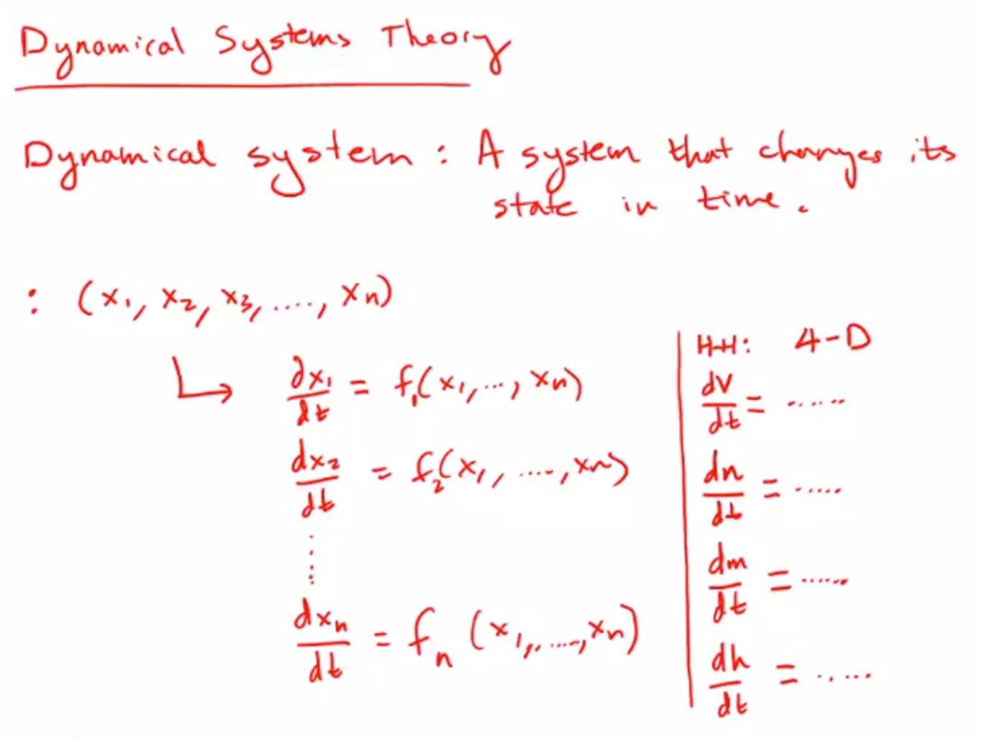

Slide 2
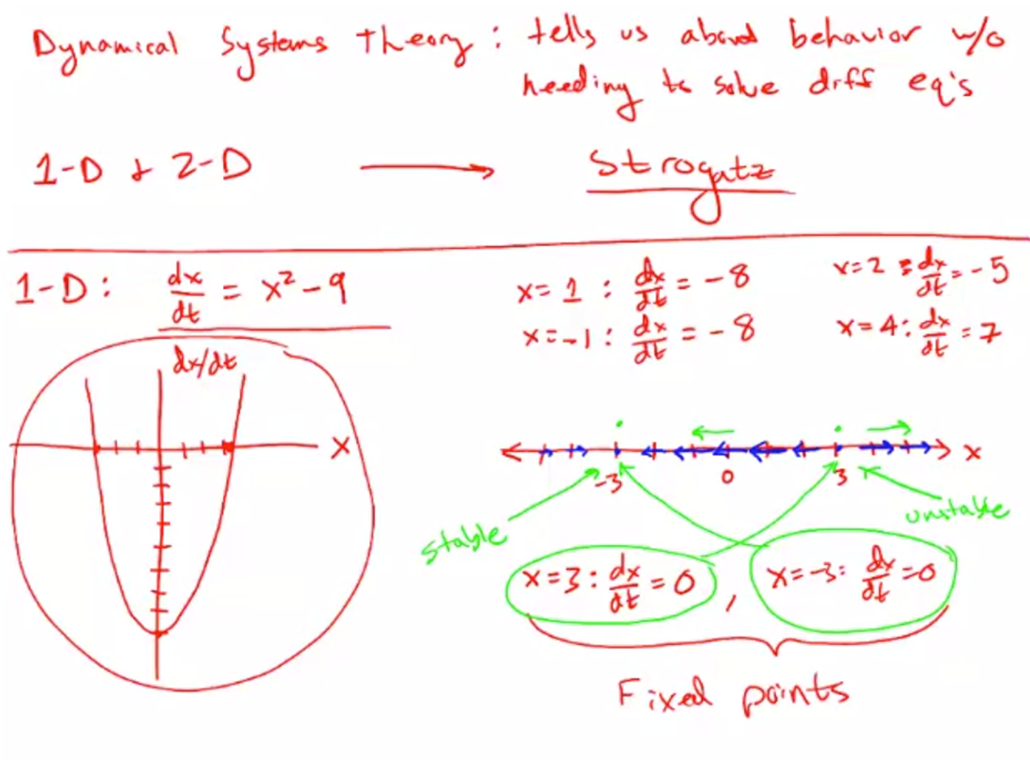

Slide 3
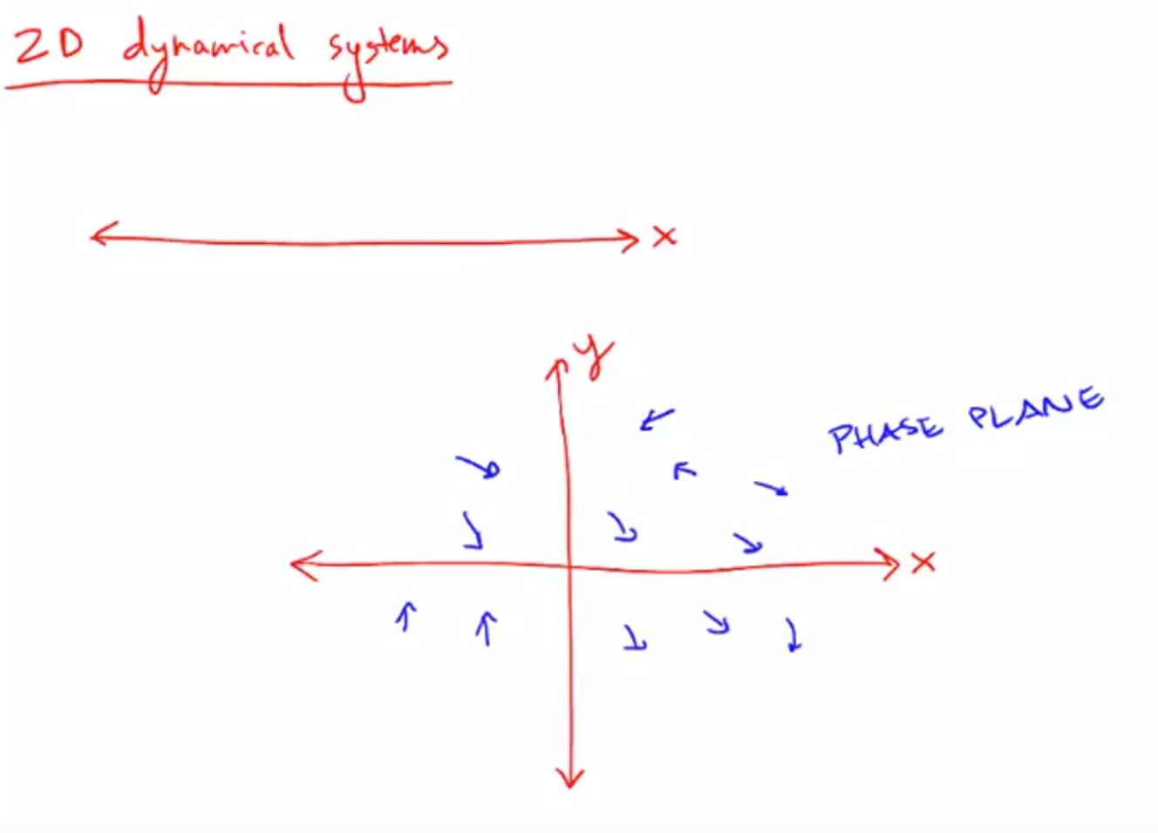

Slide 4
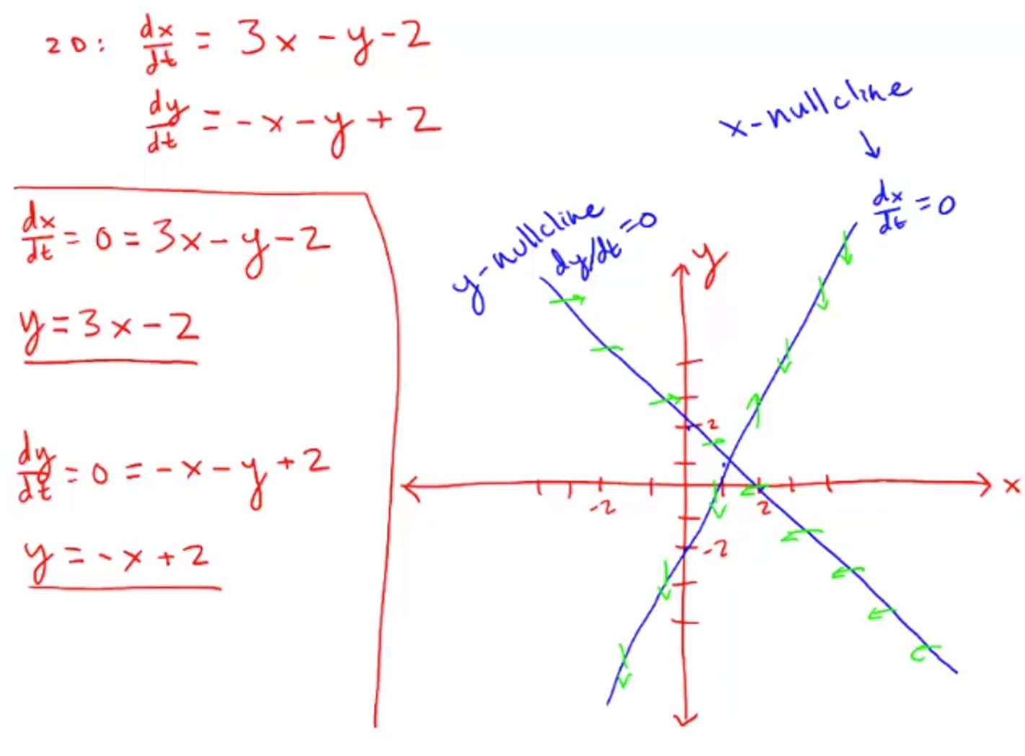
Notes:
When our system state is along the x-nullcline, it will not feel any desire to move in the x direction because dx/dt = 0.
When our system is on the y-nullcline, it will not feel any desire to move in the y direction because dy/dt = 0

Slide 5
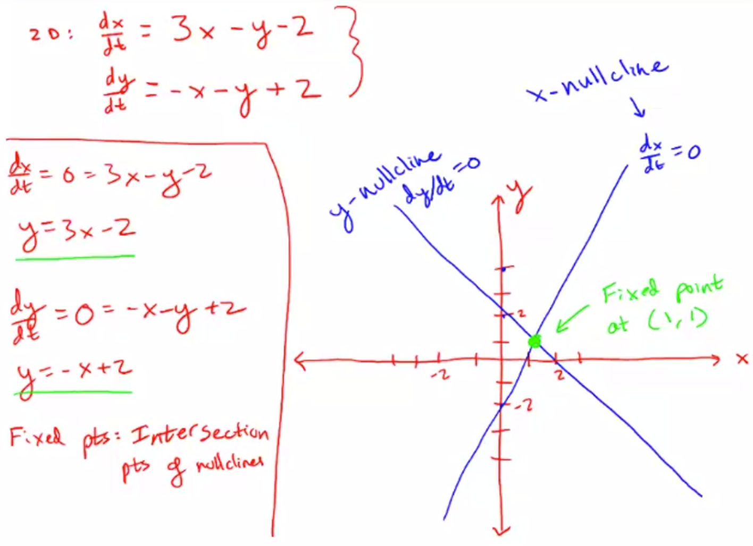

Slide 6
